Slide 1


Slide 2
Subunit 2-3:
The Central Limit Theorem

Slide 3
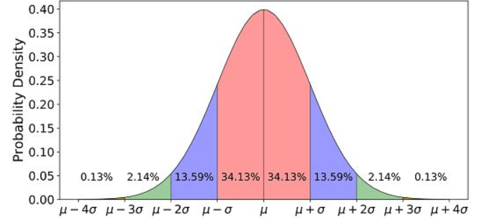
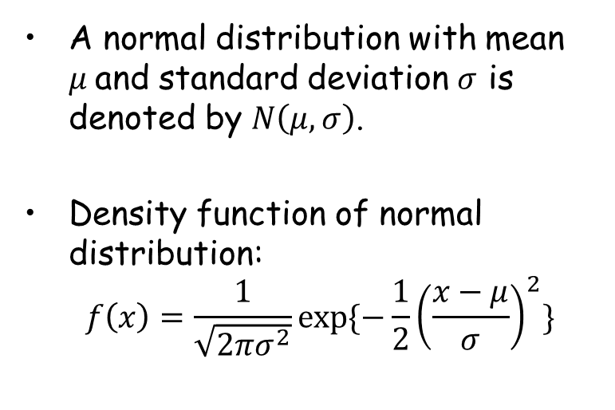
Review: Normal distribution
A normal distribution with mean $μ$and standard deviation $σ$ is denoted by $N\left(μ, σ\right)$.
Density function of normal distribution:
$$f\left(x\right)=\frac{1}{\sqrt{2πσ^{2}}}exp⁡\{−\frac{1}{2}{\left(\frac{x−μ}{σ}\right)}^{2}\}$$

Slide 4
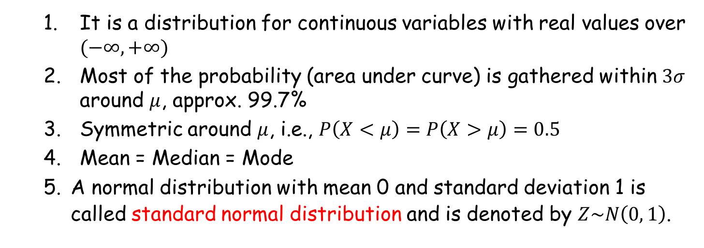
Review: Normal distribution (Cont’d)
It is a distribution for continuous variables with real values over $(−∞, +∞)$
Most of the probability (area under curve) is gathered within $3σ$ around $μ$, approx. 99.7%
Symmetric around $μ$, i.e., $P\left(X<μ\right)=P\left(X>μ\right)=0.5$
Mean = Median = Mode
A normal distribution with mean 0 and standard deviation 1 is called standard normal distribution and is denoted by $Z\sim N\left(0, 1\right)$.

Slide 5
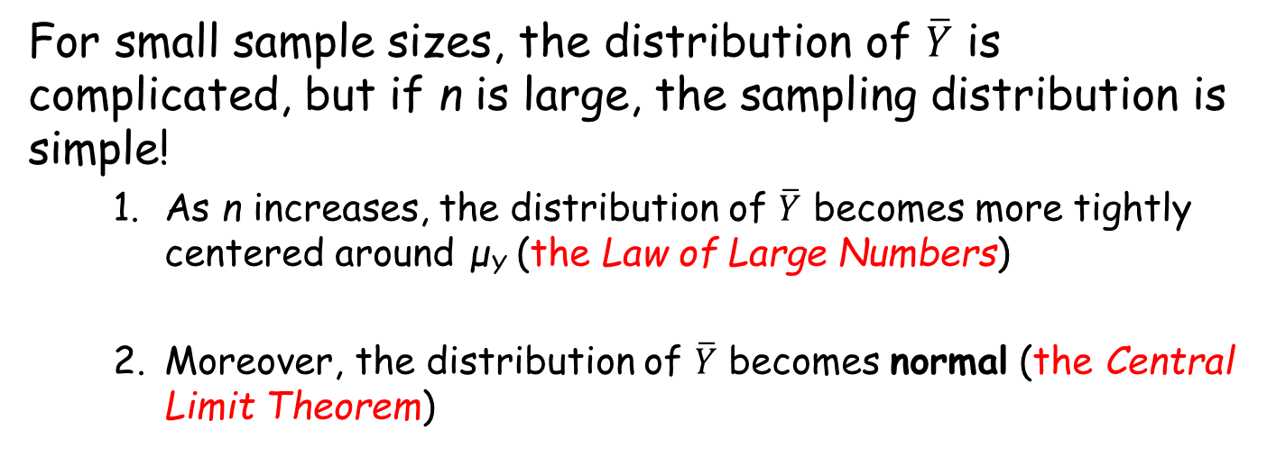

The sampling distribution of$\overline{Y}$ when n is large (Asymptotic behaviour of $\overline{Y}$)
For small sample sizes, the distribution of $\overline{Y}$ is complicated, but if n is large, the sampling distribution is simple!
As n increases, the distribution of $\overline{Y}$ becomes more tightly centered around μ_{Y} (the Law of Large Numbers)
Moreover, the distribution of $\overline{Y}$ becomes normal (the Central Limit Theorem)

Slide 6
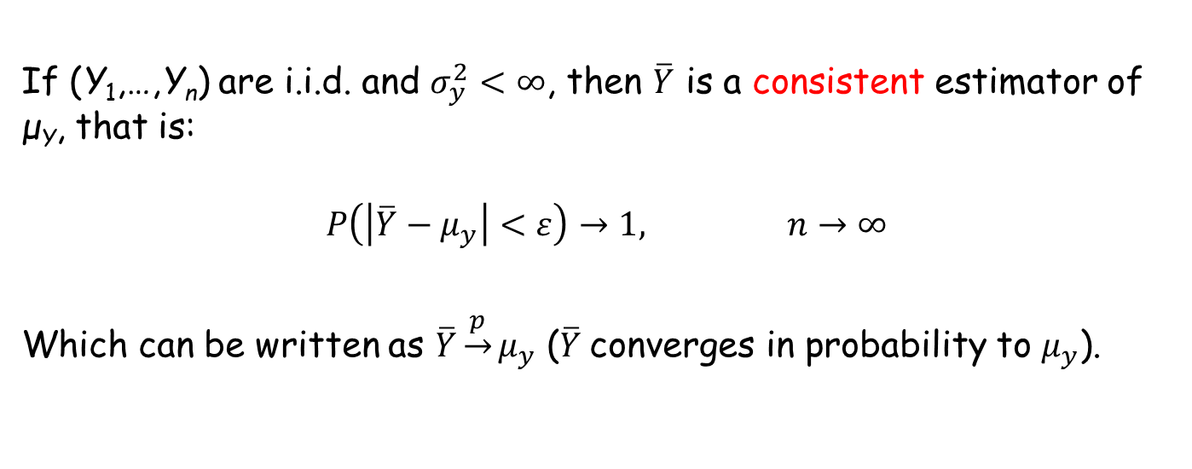
The Law of Large Numbers:
If (Y₁,…,Y_{n}) are i.i.d. and $σ_{y}^{2}<∞$, then $\overline{Y}$ is a consistent estimator of μ_{Y}, that is:
$$P\left(\left|\overline{Y}−μ_{y}\right|<ε\right)→1, n→∞$$
Which can be written as $\overline{Y}\underset{→}{p}μ_{y}$ ($\overline{Y}$converges in probability to $μ_{y}$).

Slide 7
The Law of Large Numbers
Simulation!

Slide 8
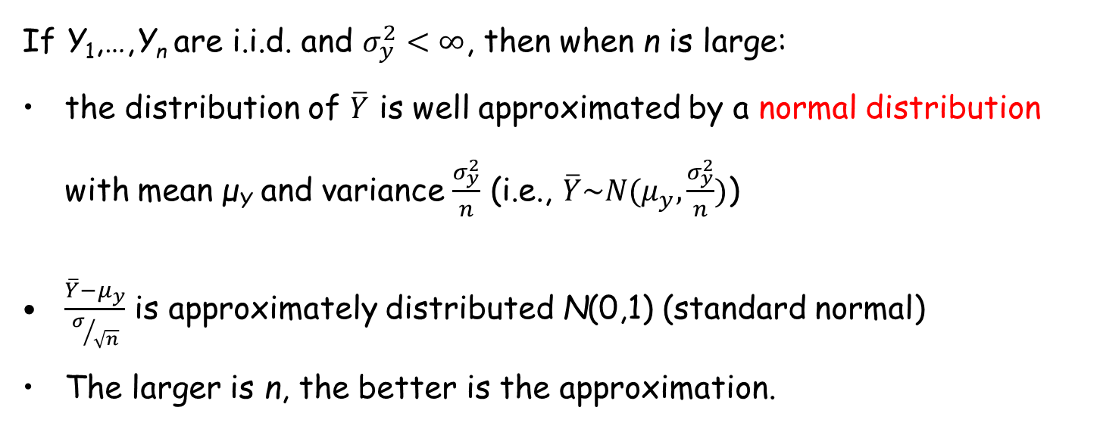
The Central Limit Theorem (CLT):
If Y₁,…,Y_{n} are i.i.d. and $σ_{y}^{2}<∞$, then when n is large:
the distribution of $\overline{Y}$ is well approximated by a normal distribution with mean μ_{Y} and variance $\frac{σ_{y}^{2}}{n}$ (i.e., $\overline{Y}\sim N(μ_{y},\frac{σ_{y}^{2}}{n})$)
$\frac{\overline{Y}−μ_{y}}{σ/{\sqrt{n}}}$ is approximately distributed N(0,1) (standard normal)
The larger is n, the better is the approximation.

Slide 9
The Central Limit Theorem (CLT):
Simulation!

Slide 10
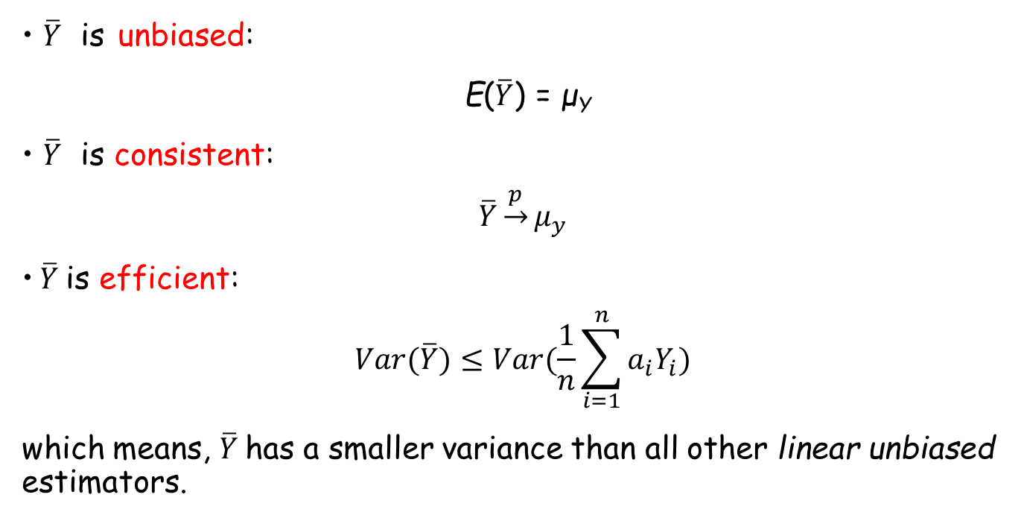

Summary: properties of $\overline{Y}$
$\overline{Y}$ is unbiased:
E($\overline{Y}$) = μ_{Y}
$\overline{Y}$ is consistent:
$$\overline{Y}\underset{→}{p}μ_{y}$$
$\overline{Y}$is efficient:
$$Var(\overline{Y})≤Var(\frac{1}{n}\sum_{i=1}^{n}{a_{i}Y_{i}})$$
which means, $\overline{Y}$has a smaller variance than all other linear unbiased estimators.

